Slide 1
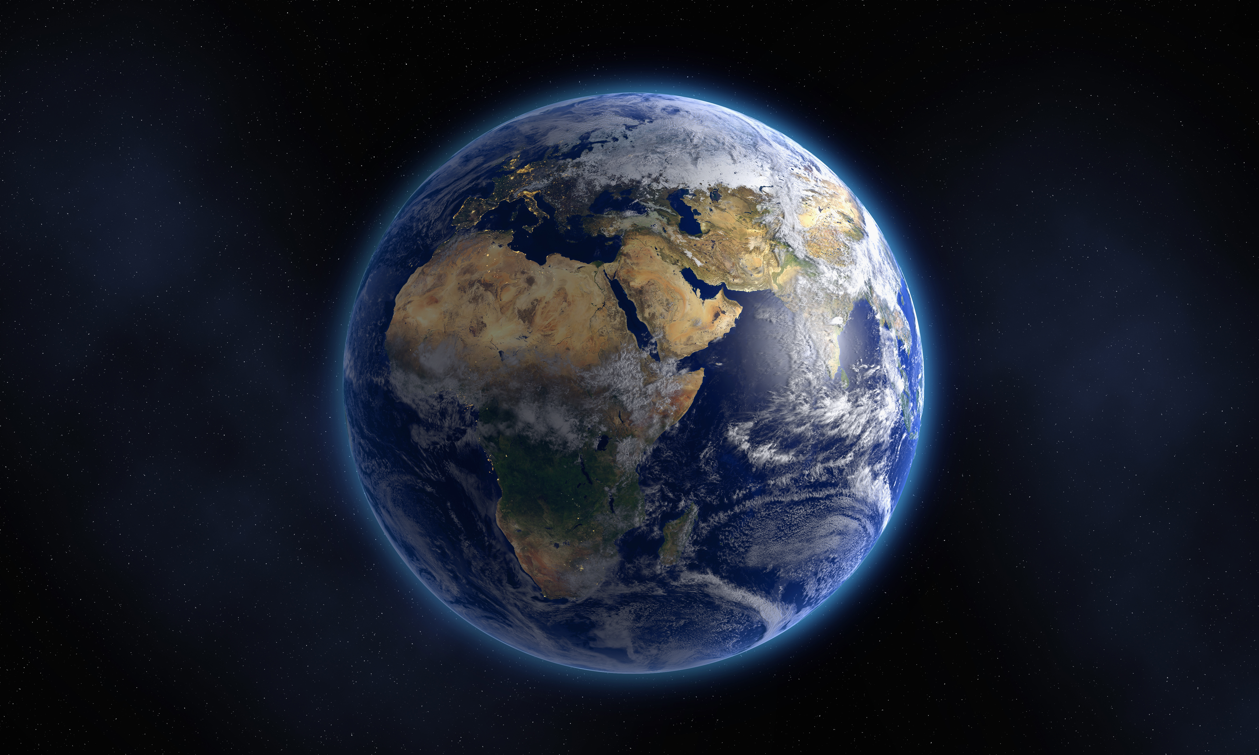
The LAST HOME FOR HUMANITY
White and Black Dwarfs

Slide 2
Introduction
Humans can survive in this universe as long as they have an energy source. Unfortunately, the universe will die. It will happen slowly, over many billions of years, but it will happen. On a universal time scale, stars like our sun will be gone in no time. Luckily, there are places that will exist practically forever from a human perspective. The corpses of dead stars. White dwarfs. They could be humanity’s last home, right before the death of the universe. What are these strange things and what happens when they finally die?

Slide 3
Life of stars
How long stars live varies drastically, depending on how massive they are. For example, really massive stars, burn hot and fast, and die violently in supernova a few million years after birth. But they’re the exception. 97% of all stars will end their existence as a white dwarf. There are 2 ways this can happen:
Small stars – so called red dwarfs burn up to trillions of years, until they eventually quietly turn into white dwarfs.

Slide 4
Life of stars
Medium – sized starts like our sun are more interesting. Imagine the sun as a huge pressure cooker that fuses hydrogen into helium in it’s core through it’s gravity. The fusion of elements releases extreme amounts of energy that pushes outwards and stabilizes the star, keeping it in a delicate balance. When the sun is old the hydrogen in the core is exhausted and the sun will begin burn helium into heavier elements. While doing so, it will shed it’s outer layers. When this process is over, more than half of the sun’s mass will be lost into space, as a spectacular planetary nebula, millions of kilometers across.

Slide 5
Life of stars
What remains will be it’s former core. A white dwarf is born, a star corpse. While it’s former self was 100 times it’s diameter, now it’s only about as big as earth, but still with about half of it’s former mass. This means it’s extremely dense. A teaspoon of white dwarf is about as massive as a car. It’s surface gravity is over 100,000 times higher than earth’s. If you tried to land on it, you’d immediately be compressed into a steaming puddle.

Slide 6
Life around a white dwarf
Life around a white dwarf is very unlikely, but possible. Most of them that exist now were former stars, that well, died, which probably ruined the planets they once had. But that’s not all: Since they are so small, a planet would need to orbit them 75 times closer than earth is to the sun to have liquid water. This proximity has up and downsides. For one, it would tidally lock the planet, giving it a permanent day and permanent night. At the edges of these day and night zones, life could be possible. But white dwarfs have a very stable energy output,so they might actually be safer to live around than red dwarfs.

Slide 7
Life around a white dwarf
But why do they shine so much longer than other star types? White dwarfs are VERY, VERY hot. Up to 40 times hotter than our sun – ranking among the hottest objects in the universe. But they are not incredibly active. All the heat inside of them is trapped and has nowhere to go. Only on it’s outer layer, can it escape into space. But space is mostly empty, so heat can’t be transferred by conduction. The only way energy can escape is by radiation. This is so inefficient that white dwarfs will take TRILLIONS of years cool down, which MAY make them humanity’s last refuge. They may be the last sources of energy in a dying universe.

Slide 8
white dwarfs
According to some scientists, white dwarfs can shine upto 100 BILLION BILLION years – 10 BILLION times longer than the universe has existed. So far into the future that no regular stars will shine anymore. Galaxies will have evaporated, and only then, will the 1st white dwarf, turn into the 1st black dwarf. When this happens, the last hope for life will die off.

Slide 9
Black dwarfs
Black dwarfs are inactive spheres with no energy left to give. Still massive enough to kill you if you get too close. So cold that they’ll be near the coldest temperatures in the universe, so dark, that they’re practically invisible. The universe will then enter it’s final stage – heat death – which will leave the universe unrecognizable. An absolutely dark and cold graveyard, with black holes and black dwarfs scattered over trillions of light years..

Slide 10
THE END OF THE UNIVERSE
We don’t know for sure what will happen with black dwarfs in the end. If the proton – one of the fundamental part of an atom – has a limited lifespan, black dwarfs will evaporate over trillions of years.
If the proton does NOT decay, black dwarfs will probably turn into spheres of pure ion via quantum tunneling, over a timeline so obscenely GIGNATIC, that calling it forever, is okay. These ion spheres will then travel completely alone through a dark universe. Nothing new will happen anymore…

Slide 11
While this may sound kind of dark,, this is so far away that for our purposes today, it might as well not happen at all. It doesn’t matter what happens in a billion trillion years, right now, we happen to live at an excellent time. Able to be in awe about a universe filled with endless stars and light and planets. And enough time to visit them 1 day…

